Slide 1







Matrix Profile II: Exploiting a Novel Algorithm and GPUs to break the one Hundred Million Barrier for Time Series Motifs and Joins
Yan Zhu, Zachary Zimmerman, Nader Shakibay Senobari
Chin-Chia Michael Yeh, Gareth Funning, Abdullah Mueen,
Philip Brisk, Eamonn Keogh
Or, how to do four hundred ninety-nine quadrillion, nine hundred ninety-nine trillion, nine hundred ninety-nine billion, five hundred million pairwise comparisons very fast.
http://www.cs.ucr.edu/~eamonn/MatrixProfile.html

Slide 2

Definition Review: Distance Profile
A seismology time series, with two repeated earthquake patterns
Query, the 1st subsequence in the time series
Obtain the z-normalized Euclidean distance between Query and each window (subsequence) in the time series. We would obtain a vector like this:
d_{1,1} | d_{2,1} | … | d_{n-m+1,1}
D₁
d_{i,j} is the distance between the i^{st} subsequence and the j^{th} subsequence.
We can obtain D₂, D₃, … D_{n-m+1} similarly.

Slide 3
Definition Review: From Distance Profile to Matrix Profile
jth
d_{1,1} | d_{1,2} | … | … | … | d_{1,n-m+1}
d_{2,1} | d_{2,2} | … | … | … | d_{2,n-m+1}
… | … | … | … | … | …
d_{i,1} | d_{i,2} | … | d_{i,j} | … | d_{i,n-m+1}
… | … | … | … | … | …
d_{n-m+1,1} | d_{n-m+1,2} | … | … | … | d_{n-m+1,n-m+1}
Note: this distance matrix is symmetric!
ith
d_{i,j} is the distance between the ith window and the jth window of the time series
Min(D₁)
Min(D₂)
Min(D_{i})
Min(D_{n-m+1})
P₁ | P₁ | … | … | ... | P_{n-m+1}
Matrix Profile: a vector of distance between each subsequence and its nearest neighbor

Slide 4
From Matrix Profile to Motif
time series
matrix profile
A pair of minimum points
The Matrix Profile has two minimum points. This pair of minimum points correspond to the 1st motif in the time series.
(the closest pair of subsequences in the time series)

Slide 5
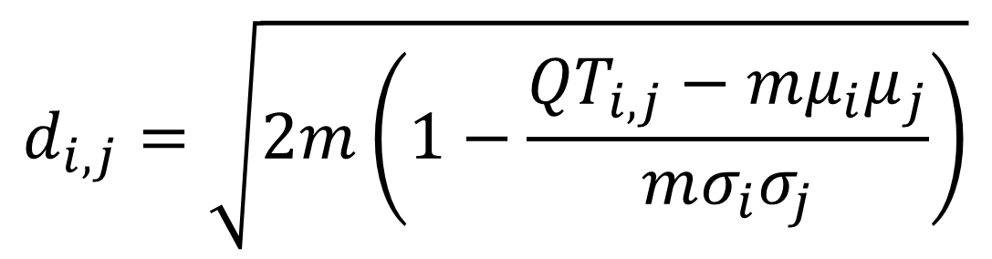
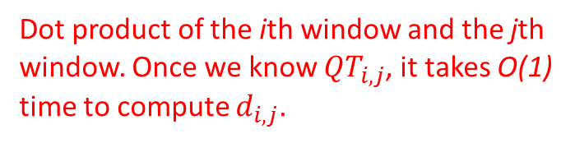
Question: How to compute Matrix Profile very fast?
Answer: We have an O(n²) time, O(n) space algorithm called STOMP to evaluate it.
To see how it works, let us first introduce an important formula:
Dot product of the ith window and the jth window. Once we know ${QT}_{i,j}$, it takes O(1) time to compute $d_{i,j}$.
$$d_{i,j}=\sqrt{2m\left(1−\frac{{QT}_{i,j}−mμ_{i}μ_{j}}{mσ_{i}σ_{j}}\right)}$$
We precompute and store the means and stds in O(n) space.

Slide 6

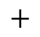





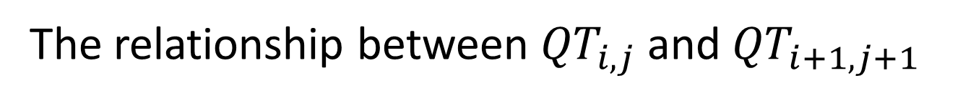


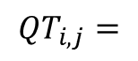


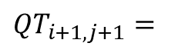






The relationship between ${QT}_{i,j}$and ${QT}_{i+1,j+1}$
… | $$t_{i}$$ | $$t_{i+1}$$ | $$t_{i+2}$$ | … | $$t_{i+m−1}$$ | $$t_{i+m}$$ | …
$${QT}_{i,j}=$$
$$×$$
$$+$$
$$×$$
$$+$$
$$×$$
$$+$$
…
$$+$$
$$×$$
… | $$t_{j}$$ | $$t_{j+1}$$ | $$t_{j+2}$$ | … | $$t_{j+m−1}$$ | $$t_{j+m}$$ | …
… | $$t_{i}$$ | $$t_{i+1}$$ | $$t_{i+2}$$ | … | $$t_{i+m−1}$$ | $$t_{i+m}$$ | …
${QT}_{i+1,j+1}=$
$$×$$
$$+$$
$$×$$
$$+$$
$$+$$
$$×$$
$$+$$
$$×$$
… | $$t_{j}$$ | $$t_{j+1}$$ | $$t_{j+2}$$ | … | $$t_{j+m−1}$$ | $$t_{j+m}$$ | …
$${QT}_{i+1,j+1}\text{=}{QT}_{i,j}−t_{i}t_{j}+t_{i+m}t_{j+m}$$
$O\left(1\right)$ time complexity!

Slide 7
STOMP Algorithm: Computing the ith line
d_{1,1} | d_{1,2} | … | d_{1,n-m+1}
d_{2,1} | d_{2,2} | … | d_{2,n-m+1}
… | … | … | …
d_{i,1} | d_{i,2} | … | d_{i,n-m+1}
… | … | … | …
d_{n-m+1,1} | d_{n-m+1,2} | … | d_{n-m+1,n-m+1}
QT_{i-1,1} | QT_{i-1,2} | … | QT_{i-1,n-m} | QT_{i-1,n-m+1}
QT_{i,1} | QT_{i,2} | QT_{i,3} | … | QT_{i,n-m+1}
min
min
min
min
Distance Profile
d_{i,1} | d_{i,2} | d_{i,3} | … | d_{i,n-m+1}
P₁ | P₂ | … | P_{n-m+1}
Update if Smaller
Matrix Profile
P₁ | P₂ | P₃ | … | P_{n-m+1}
We pre-calculate QT_{x,1} and QT_{1,x} (x=1,2,3,…,n-m+1).
Then iterate through i=2, 2, 3, …, n-m+1.

Slide 8
Porting the algorithm to GPU
First Kernel Launch: Update P_{i} to P_{n-m+1}
…
QT_{i-1,i-1} | QT_{i-1,i} | … | QT_{i-1,n-m} | QT_{i-1,n-m+1}
…
QT_{i,i} | QT_{i,i+1} | … | QT_{i,n-m+1}
QT_{i-1,1} | QT_{i-1,2} | … | QT_{i-1,n-m} | QT_{i-1,n-m+1}
d_{i,i} | d_{i,i+1} | … | d_{i,n-m+1}
QT_{i,1} | QT_{i,2} | QT_{i,3} | … | QT_{i,n-m+1}
Update if Smaller
Optimize
P_{i} | P_{i+1} | … | P_{n-m+1}
d_{i,1} | d_{i,2} | d_{i,3} | … | d_{i,n-m+1}
Update if Smaller
Second Kernel Launch: Evaluate Final Value of P_{i}
d_{i,i+1} | d_{i,i+2} | … | d_{i,n-m+1}
P₁ | P₂ | P₃ | … | P_{n-m+1}
min
d_{min}
Update if Smaller
P_{i}

Slide 9
Comparison of STAMP, STOMP and GPU-STOMP
For a fix subsequence length m=256: time
Algorithm n | 2¹⁷ | 2¹⁸ | 2¹⁹ | 2²⁰
STAMP | 15.1 min | 1.17 hours | 5.4 hours | 24.4 hours
STOMP | 4.21 min | 0.3 hours | 1.26 hours | 5.22 hours
GPU-STOMP | 10 sec | 18 sec | 46 sec | 2.5 min
For large data, and for the very first time in the literature, 100,000,000
Algorithm m | n | 2000 | 17,279,800 | 400 | 100,000,000
STAMP (estimated) | 36.5 weeks | 25.5 years
STOMP (estimated) | 8.4 weeks | 5.4 years
GPU-STOMP | 9.27 hours | 12.13 days

Slide 10
Comparing the speed of STOMP with existing algorithms
For a time series of length $2^{18}$: CPU time(memory usage)
Algorithm m | 512 | 1,024 | 2,048 | 4,096
STOMP | 501s (14MB) | 506s (14MB) | 490s (14MB) | 490s (14MB)
Quick-Motif | 27s (65MB) | 151s (90MB) | 630s (295MB) | 695s (101MB)
MK | 2040s (1.1GB) | N/A (>2GB) | N/A (>2GB) | N/A (>2GB)
Note: the time and space cost of STOMP is independent of how the data looks.

Slide 11
Case Study I: Parameter Setting
There is only one parameter to set: the subsequence length m, however, the result is not sensitive to it…
raw seismograph data
matrix profiles
m=4000
m=2000
m=1000
0min
30min

Slide 12
Case Study II: The Benefit of Using Matrix Profile for Motif Discovery
1st motif is a pair of sensor defects
1996
2009
5st motif is a pair of matching seismology patterns
1996, ID:30104990
2009, ID:371327705
0
1000
2000
3000

Slide 13
Case Study III: Earthquake Swarms
The matrix profile of a seven-minute snippet from a seismograph recording at Mount St Helens
“... so regularly that we dubbed them ‘drumbeats’. The period between successive drumbeats shifted slowly with time, but was 30–300 seconds”
* We are not only providing a linear-space algorithm that is much faster than all existing motif-discovery algorithms; we are actually providing much more information than just the top k motifs in the time series with STOMP.

Slide 14

Case Study III: Penguin Telemetry
7.5 hours of recording at 40Hz took GPU-STOMP only 2.5 minute to run.
Y-axis magnetometry
0.2
0.1
0
-0.1
514,000
524,000
0
1000
2000

Slide 15
Summary
We introduced STOMP and GPU-STOMP, the first algorithm that is capable to discover motifs for the longest time series in the literature, 100,000,000.
The algorithm costs only linear space and the speed is independent of how the data looks like.
Matrix Profile provides the information of the nearest neighbors of all subsequences in the time series.
STOMP can discover much more than just motifs.
Paper, code and datasets available at: http://www.cs.ucr.edu/~eamonn/MatrixProfile.html

Slide 16
Questions?

